Slide 1

Building a New Career in 5 Hours a Week
Michael Bender
Cloud Advocate
Microsoft
Level: Beginner-Expert
Notes:
Good afternoon Welcome to day 3 of tech mentor I hope everybody's been having a great week a week filled.
With learning and opportunities to network to learn new technologies to learn new things to make yourself better than you were the day before.
My name's Michael Bender and welcome in our session on building a new career in 5 hours a week.
It's so great that we have this time together especially at the end of the week normally.

Slide 2

Helping IT Pros
My Career
Notes:
Over that last decade, through numerous mediums I’ve shared my knowledge with IT Pros in hopes they can move up their ladders
My job is a Cloud Advocate at Microsoft
It’s a vehicle for me to do my life’s work
Not everything we’ll discuss today will work for each of you. However, you’ll have lots of things to take with you on the trip home.
Prior to that I was a college teacher a professional published author or plural sight I wrote a blog articles I did some webinars I did a number of things
a number of different jobs.
That all enkompass myof helping I'd probs be better.
Helping IT Pros
Delivering Content
Sharing
Networking
Teaching
When I ask about what people do, they often say what their job is and who they work for.
It's great that we have this time together
What you gave up to be here
Generally, each of you are here to be better than you were yesterday. And hopefully that means building a new or better career.

Slide 3
The Big Show
The What and Why of Careers
Your Career in 4 Parts
5 Hours to be Better Tomorrow

Slide 4

Your Career
What is your Career
Notes:
It’s what you are passionate about
It’s not a job; its what you want to do
Aka your life’s work
You are the master of your career and need to own it
So what is your career so when I think about careers.
I think of it for a high level but what are you passionate about what gets you up in the morning.
It's not a job. It's what you want to do over the space of 5 or 10 years.
Jobs are the tools to achieve your career ambitions
Aka your life’s work
So You need to really spend some time thinking about what this is.

Slide 5

Invest in You
Why Career
Notes:
Need Graphic for investing in You
How many people invest for their retirement or save for the future
How many spend time outside of working learning for themselves?
Why wouldn’t you invest in yourself
Only you are truly invested in your career
Investing in your self is the best investment you can make.
Own Your Career - Invest in You
Learning more will make you better...period.
Learn a set of tools to meet your needs

Slide 6

JOB
Employers invest in…
Notes:
Pay for me to go to training
Send me to a conference
Expects me to learn on my own
Why? Focused on Job
Only you are 100% invested in your career. Because at the end of the day, you are responsible for getting to where you want to go.
Transition: That’s why you need to be thinking about what about your career, and not your job. So let me give you an example
Click

Slide 7

You never know what tomorrow brings
Notes:
Share war stories, ask questions, etc
I always work to try and get them learning (powershell,git,azure)
One member has a company merger
Layoff status is unknown so they need to skill-up
Said person has repeatedly said ‘I don’t have time to learn X and Y because my company doesn’t use it’
Transition: Now you know why you need to invest in your career; let’s take a look at your career in more depth

Slide 8
The Four Career Pillars
Vision
Knowledge
Brand
Of
You
Luck
Notes:
Broken these down into 4 high-level areas
Click
First is vision – What do you want to do & Where do you want to go. It is your North Star for managing your career
Click
Next is your knowledge. What are things you bring to the table & also what do you want to learn? Building this area supports the work in other areas.
Click
Then it’s what I refer to as the brand of You and it's about your personal and professional brand. What do you represent? What what is your brand? It’s really about who you are and/or want to be.
Click
And then the fourth piece of the pie is luck.
For the most part a lock is going to be one of those things that no matter what you do you often and sometimes need to be
in the right place at the right time for things to happen.

Slide 9

Notes:
When I think of Vision, often times this quote comes to mind
Goal: What do you want to do when you grow up?
‘What you want to do
What is your Passion
What are your goals
How do you figure this out?
Conferences like this are great places to learn about new careers and areas of technology.
Networking with people and finding out what they do.
All else fails, search Hot Careers for 2018
So an important part of career building and maintenance, is having direction
In business, often discuss their mission statements.
Click

Slide 10
Mission Statement
What
For Whom
Why
Notes:
Mission
What
For Whom
Why
What do we do today? For whom do we do it? What is the benefit? In other words, Why we do what we do? What, For Whom and Why?
A mission statement sets boundaries for you
Each of you should work on a mission statement for yourself to use as a guide for your career. To help, let me share mine.

Slide 11
My Mission Statement
“Empower people through advocacy and engagement to be better today than they were yesterday so they can achieve their life’s work.”
Notes:
Makes decision making on what I’m doing easier as I can match the work against whether it is achieving my mission
You should think about building out your mission statement. It’s hard work; I’m not going to lie. It’s taken a while for me to come up with mine. But Once you have this and have an idea for a career. You need to realize something…

Slide 12

Rome wasn’t built in a day and neither will your career
Notes:
You need to have an idea of what you want to do
So let’s say you want to work want to build cloud infrastructures aka a cloud Architect
If you are an SMB client support specialist, you won’t be a future 500 cloud architect overnight
It may take years
But the journey will be worth it
Personal Story: I’m an Ops guy born and bred in Windows through the GUI. One day a saw that my students needed to know PowerShell. So for that to happen, I needed to know PowerShell to a level I could teach them. That didn’t happen overnight. It took a few years for me to get to a level where I could teach PowerShell to my students. To get their, it required setting goals for myself.
Goal settings is paramount to moving forward. Click

Slide 13

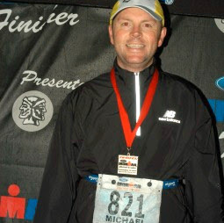
Goals
Notes:
You need targets to aim for as you move
Short, medium, long distance
Chances are over the years you've had certain goals and people always talk about setting goals and you really need to have a target to aim for.
Otherwise, we often just go with the flow and wonder why things don’t get done, or go our way.
September 10, 2016 at 11:56 Mike Reilly, the voice of Iron Man said “Michael Bender you are an IronMan
The Best goals are ones that meet a specific criteria. Click

Slide 14

Goals
Notes:
You need targets to aim for as you move
Short, medium, long distance
Chances are over the years you've had certain goals and people always talk about setting goals and you really need to have a target to aim for.
Otherwise, we often just go with the flow and wonder why things don’t get done, or go our way.
September 10, 2016 at 11:56 Mike Reilly, the voice of Iron Man said “Michael Bender you are an IronMan
The Best goals are ones that meet a specific criteria. Click

Slide 15

Goals
Notes:
You need targets to aim for as you move
Short, medium, long distance
Chances are over the years you've had certain goals and people always talk about setting goals and you really need to have a target to aim for.
Otherwise, we often just go with the flow and wonder why things don’t get done, or go our way.
September 10, 2016 at 11:56 Mike Reilly, the voice of Iron Man said “Michael Bender you are an IronMan
The Best goals are ones that meet a specific criteria. Click

Slide 16

Goals
Notes:
You need targets to aim for as you move
Short, medium, long distance
Chances are over the years you've had certain goals and people always talk about setting goals and you really need to have a target to aim for.
Otherwise, we often just go with the flow and wonder why things don’t get done, or go our way.
September 10, 2016 at 11:56 Mike Reilly, the voice of Iron Man said “Michael Bender you are an IronMan
The Best goals are ones that meet a specific criteria. Click

Slide 17

Goals
Notes:
You need targets to aim for as you move
Short, medium, long distance
Chances are over the years you've had certain goals and people always talk about setting goals and you really need to have a target to aim for.
Otherwise, we often just go with the flow and wonder why things don’t get done, or go our way.
September 10, 2016 at 11:56 Mike Reilly, the voice of Iron Man said “Michael Bender you are an IronMan
The Best goals are ones that meet a specific criteria. Click

Slide 18
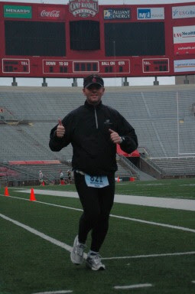


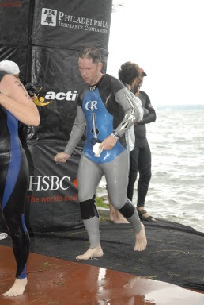
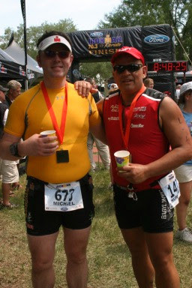
Goals
Notes:
You need targets to aim for as you move
Short, medium, long distance
Chances are over the years you've had certain goals and people always talk about setting goals and you really need to have a target to aim for.
Otherwise, we often just go with the flow and wonder why things don’t get done, or go our way.
September 10, 2016 at 11:56 Mike Reilly, the voice of Iron Man said “Michael Bender you are an IronMan
The Best goals are ones that meet a specific criteria. Click

Slide 19
SMART Goals
Specific
Measurable
Achievable
Realistic
Time-bound
Notes:
To make sure your goals are clear and reachable, each one should be:
Specific (simple, sensible, significant).
Measurable (meaningful, motivating).
Achievable (agreed, attainable).
Relevant (reasonable, realistic and resourced, results-based).
Time bound (time-based, time limited, time/cost limited, timely, time-sensitive).
Example 2:
Be able to write a script with PowerShell
Complete PowerShell Scripting in a Month of Lunches by September 15th by spending 5hrs a week on reading and activities.
Once you have your goal, knowledge and learning play a part in achieving that goal. Click

Slide 20
Knowledge
Notes:
What do you know – Baseline of where you are at
What do you want to learn – Where do you want to go
Point A > Point B
Get there through learning and experiences
The pursuit of knowledge should be a daily endeavor and the reason is change.
Click

Slide 21

Embrace Change
Notes:
Simply put, our industry is all about change. You know change is a daily occurrence. Instead of going against the tide of change, ride it.
Many of us know that sysadmin, like my good friend Rick Claus would say, A server hugger. They cling onto what they know in hopes that it will get them through. But it won’t in most instances so by embracing change we can move forward as our industry moves forward. And to be successful navigating change, we need to be learning constantly. Click

Slide 22

Being a Life-Long learner
Notes:
Part of that is being a life-long learner.
Not only learning knowledge, but learning from others. We live in an amazing world full of change, and we have so much we can learn before we are done here.
So how do you become a life long learner?
Click

Slide 23

What did you learn today?
Notes:
By Committing to learn something new everyday.
It doesn’t matter what it is
Learn 1/day
Read a blog, Wikipedia article, complete a how to
While this will cover small areas of knowledge,
To effectively learn say job-related topics, you need to know how you learn effectively, and more importantly how you learn.
Click

Slide 24

Focused Learning
Notes:
Multi-Tasking is a falicy. If you really want to learn something, you need to Pick 1 area to focus on. Try to learn multiple things will often leave you like when I do home projects…
“I’ve completed 10 projects to 90% but nothing to the finish line”
I'm going to learn Azure is a terrible idea; Not a good learning focus
Learning azure would be the basis for a good goal for your career
I'm going to learn how VMs work in Azure is a better idea

Slide 25




Know Your Learning Style
Notes:
Video
Audio
Reading
Hands-On
Know this is so important as it will help you determine the materials for learning

Slide 26

Resources

Slide 27
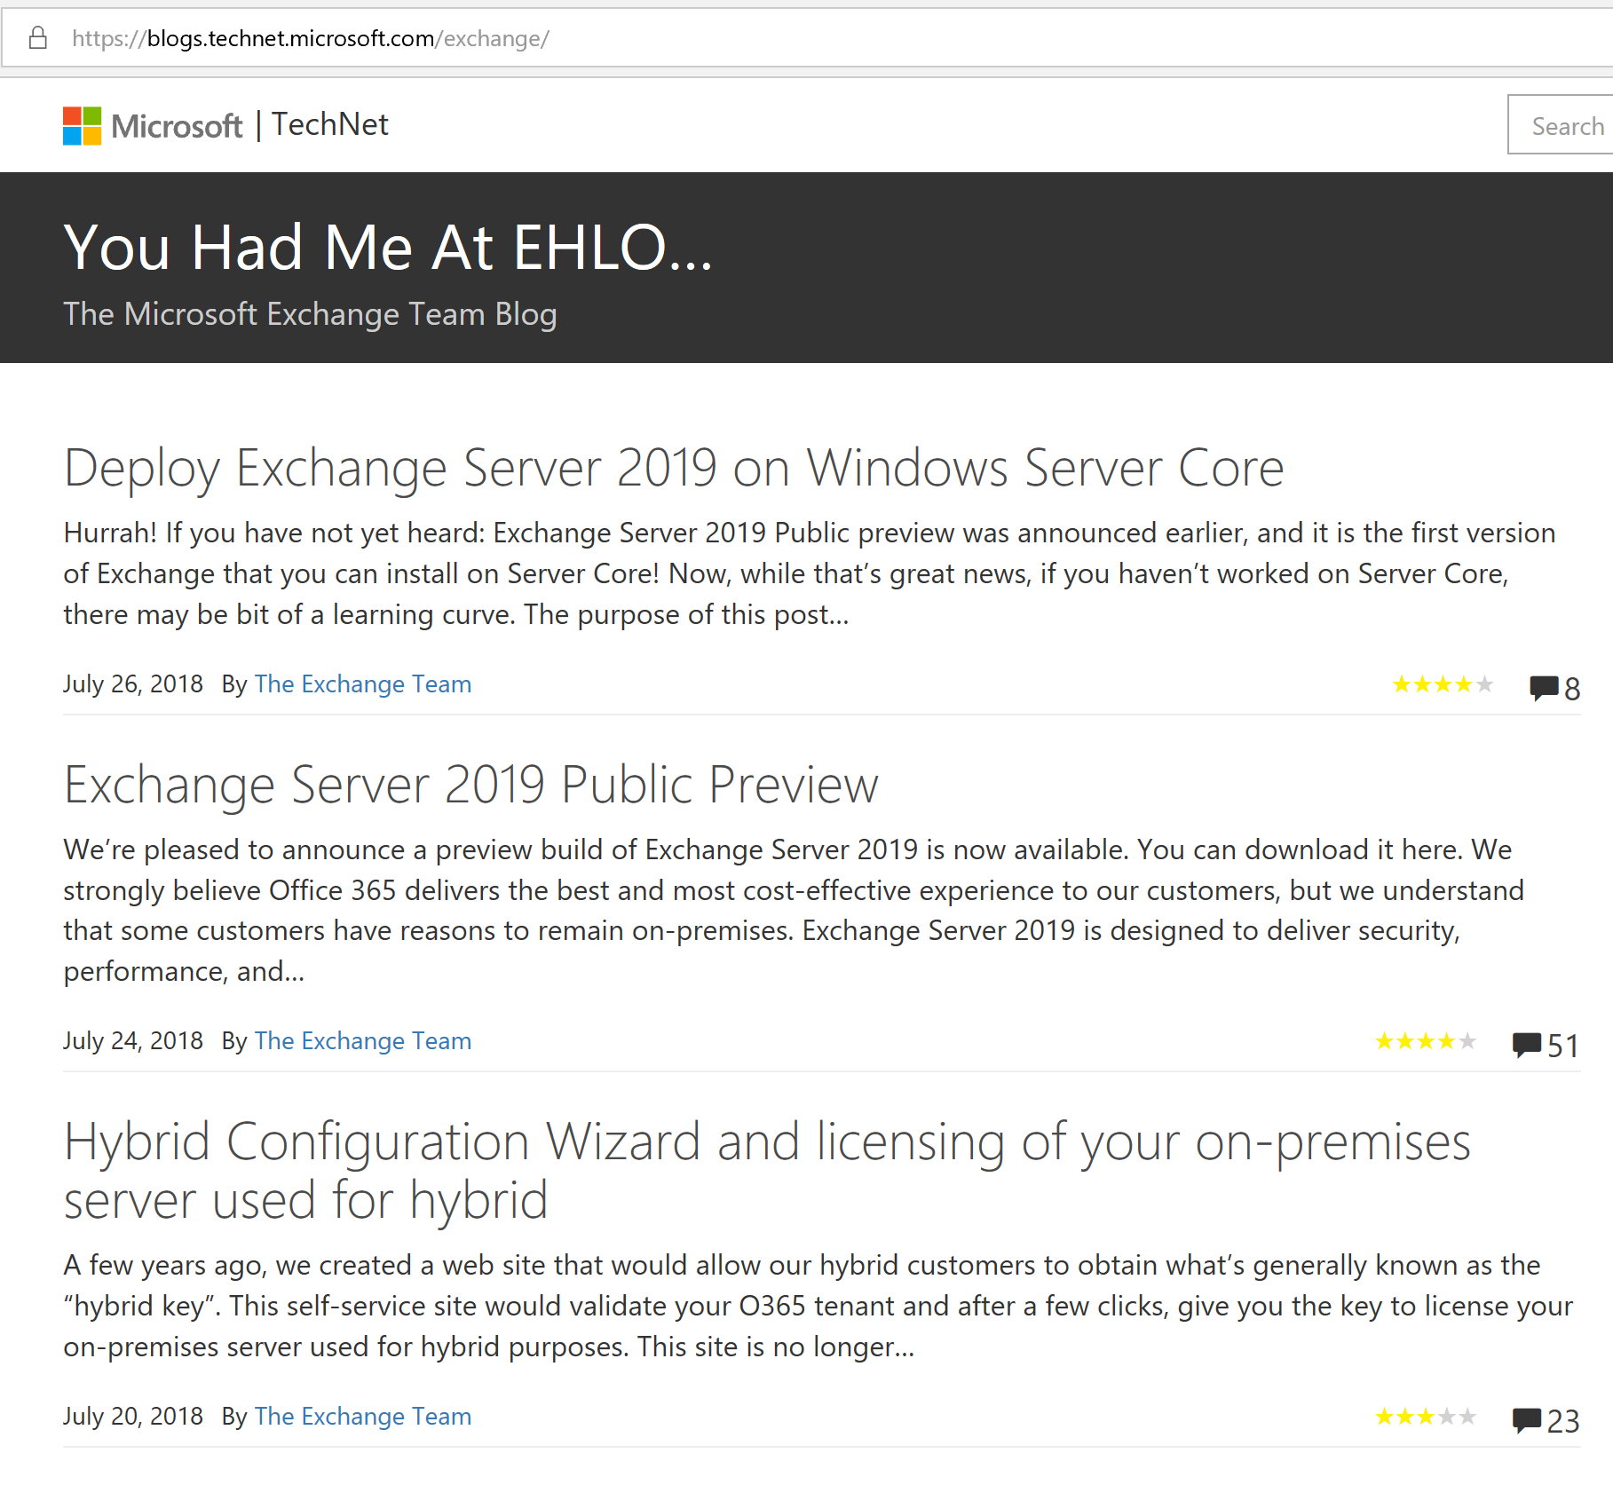
Blogs

Slide 28
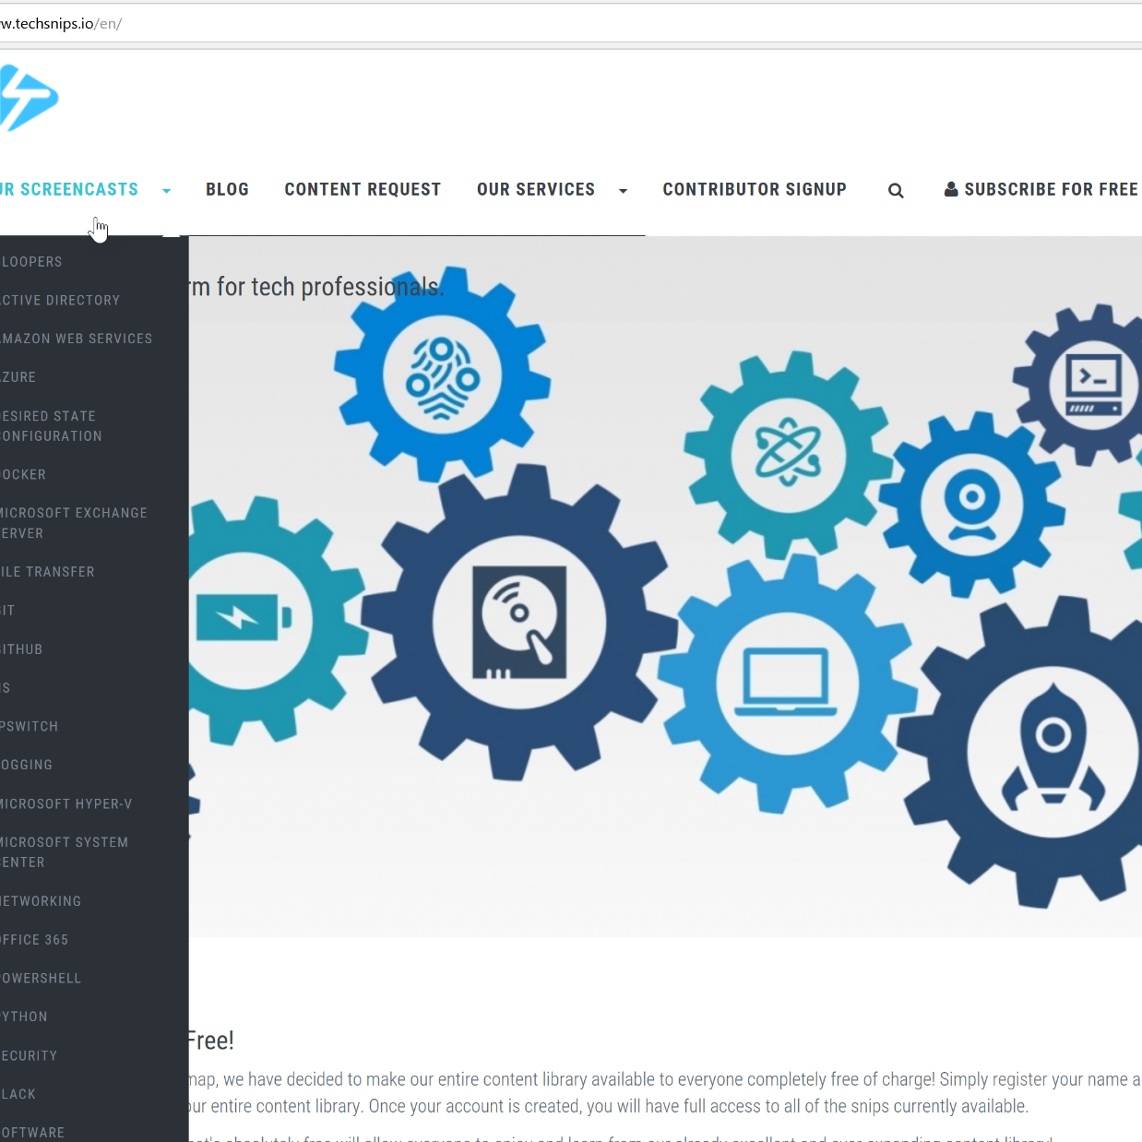
Videos/Screencasts

Slide 29
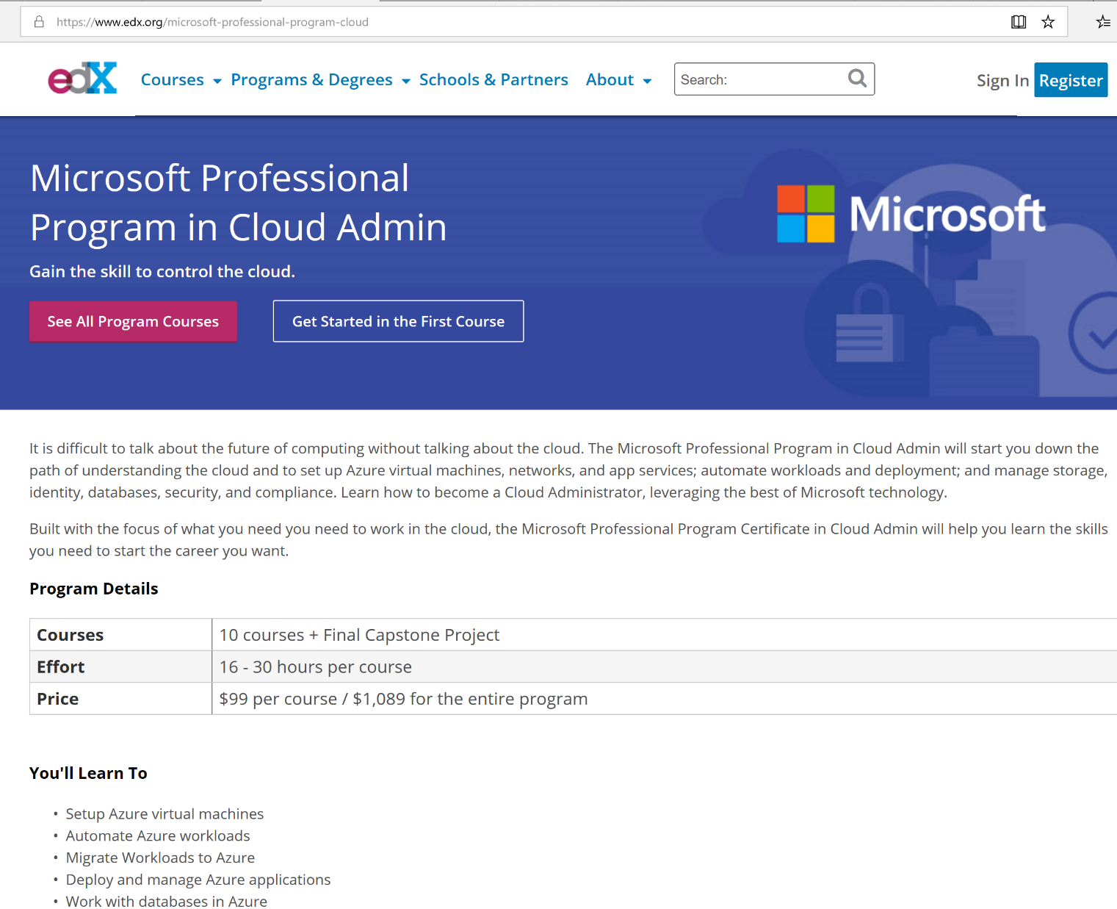
Online Learning

Slide 30
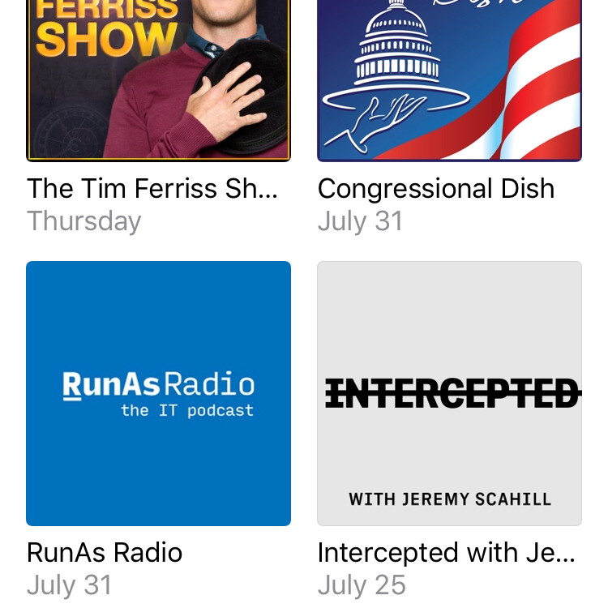
Podcasts

Slide 31
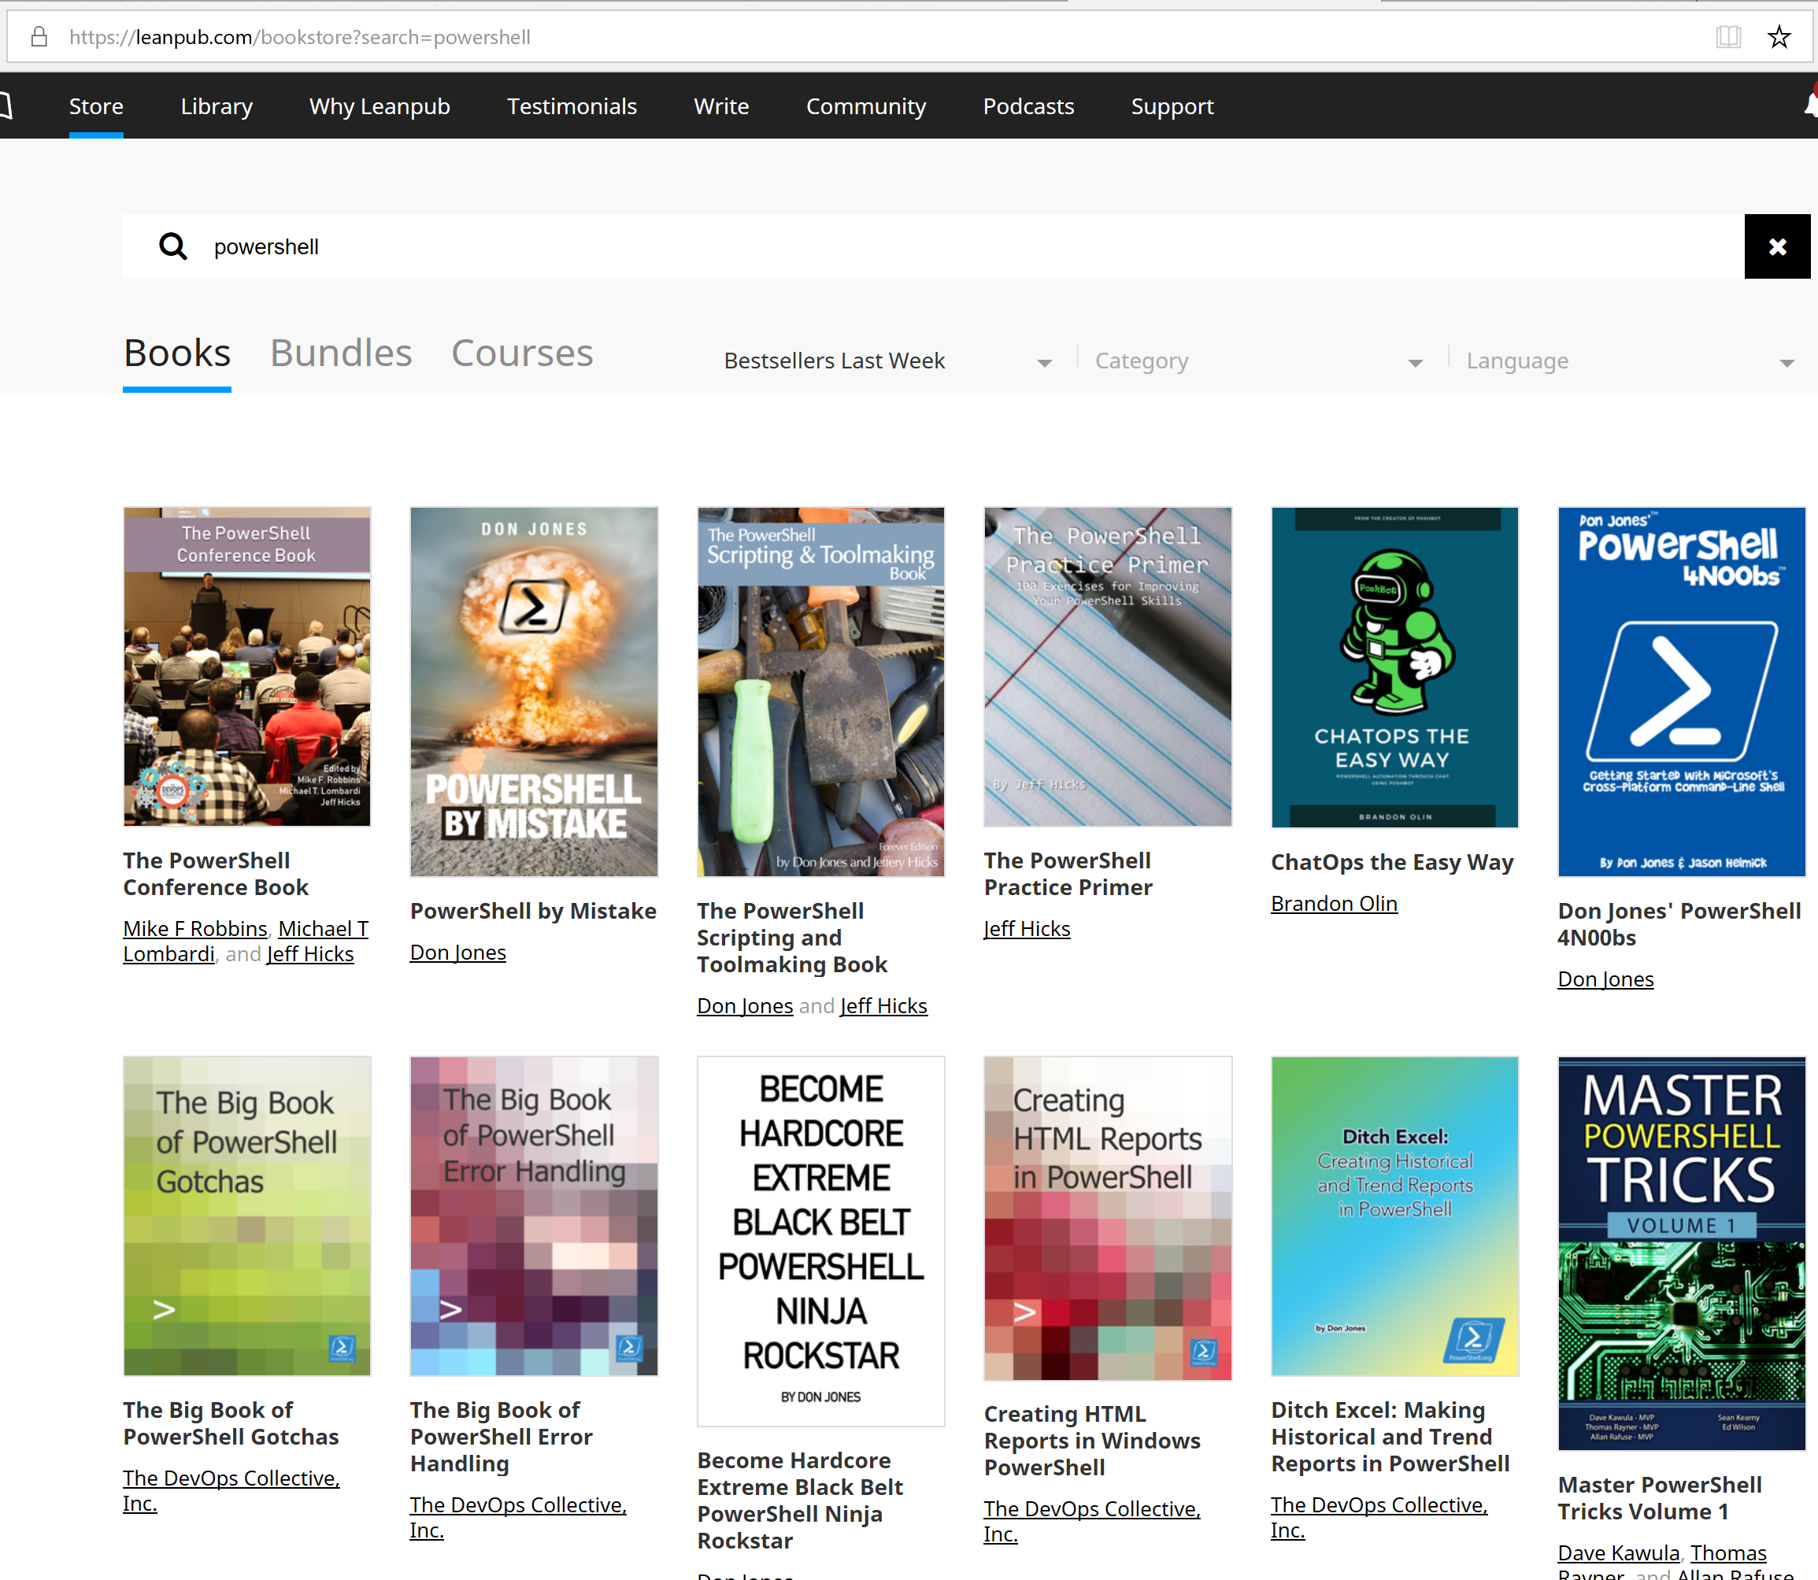
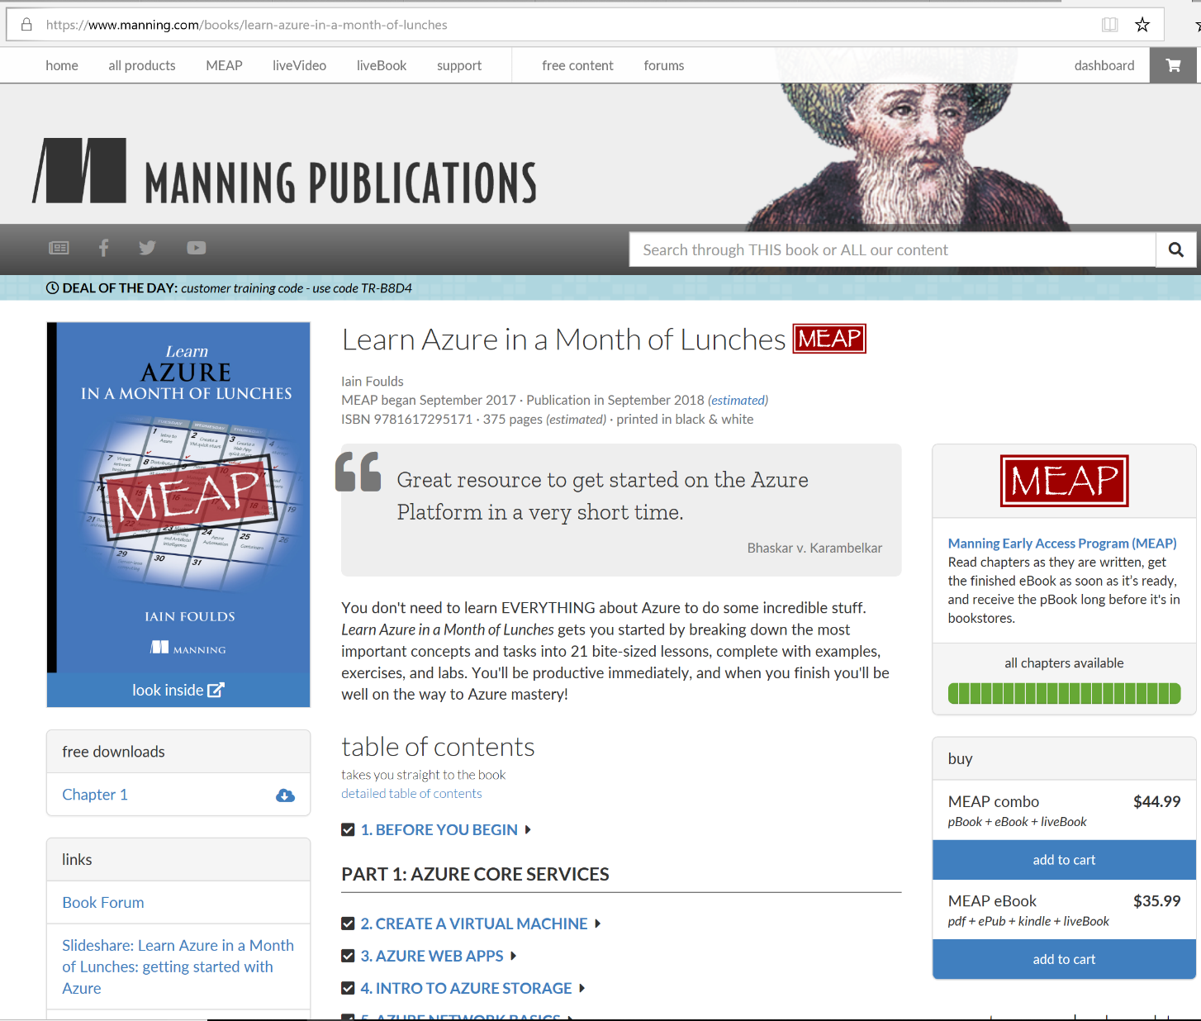
Books

Slide 32
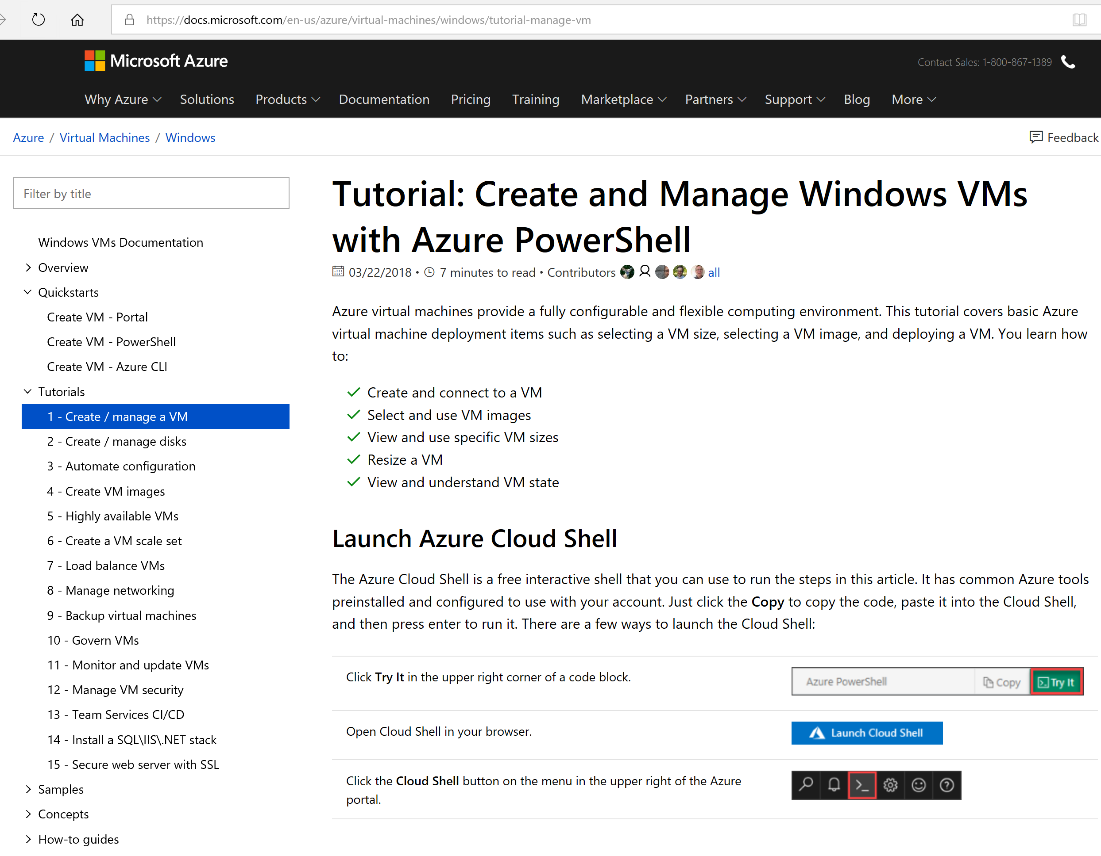
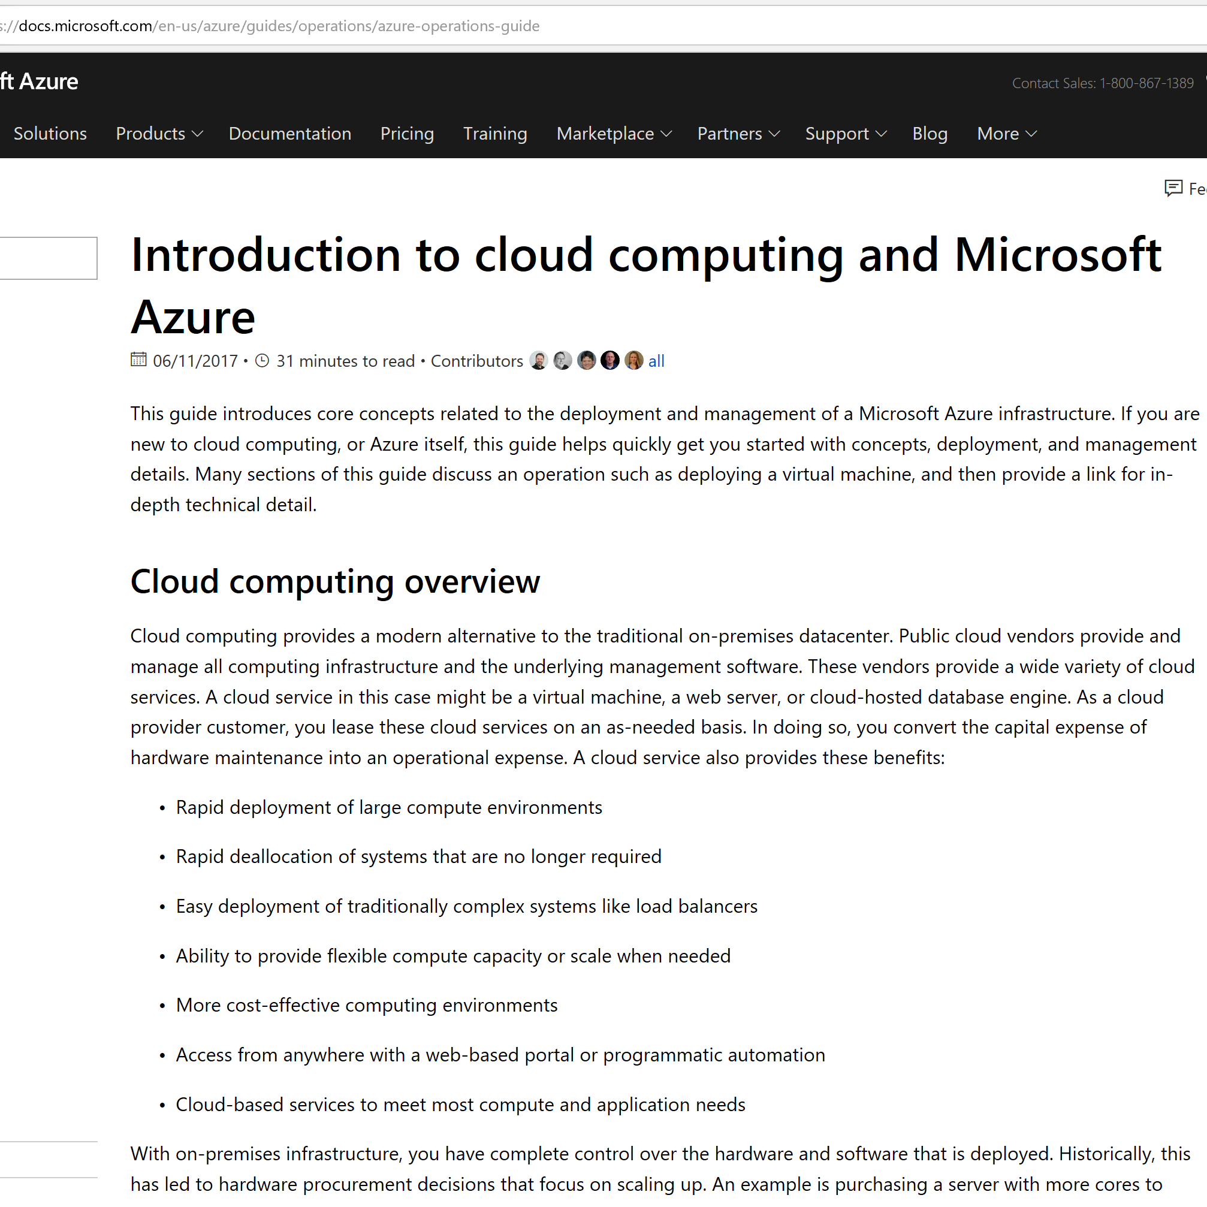
Documentation

Slide 33

Hands On
Notes:
Hyper-V or Vmware Workstation
Trial offers from Cloud vendors
Most of you in the audience this is a big area that you're used to working in a good way to get started with hands on learning is using the

Slide 34
Demo
Notes:
Demo docs

Slide 35

Brand of You
Brand of You
Notes:
Who are you
Who is your network
What is your 30-second Elevator pitch
So when we talk about the brand of you.
Your personal brand is probably one of the most important pieces of your career. It’s who you are, what you represent.
It may sound like marketing, but that is what you are doing when you apply for a new job role, or a consulting contract. Selling yourself to the ‘buyer’ aka employer

Slide 36

Networking
Meetups
Notes:
Join a community
User Group
Member > Speaker
FB group
Reddit (though I’m not a user)
Stack OverFlow
One of the things that those of us that have been around for awhile know is that one of the most important networks has nothing to do with moving ones
and zeros. It's all about the networks that you build.
That open up the next door for that next role that allow you to be able to solve things creating a network around you for not only your personal professional
life. That gives you a great way of people to tap into.
All the time I hear about.
People that aren't in the different communities that are in depth to publish job postings and they'll be looking for a role within the community before they'll go out publicly
because to be quite honest if you work in a company.
And you have a role come up.
You're going to go to a community that you're invested in that you try know the people there that you trust the people of trying to bring somebody in that
you may even know on a person on a personal basis.
We'd all rather work with people that we know that we know what they bring to the table than just somebody off the streets So what are some different ways
that you can network. Meetups user groups those are all good things Facebook depending on whether or not you like that platform for the the communities I've been in Facebook
You can use Reddit I'm not a big fat around it but I know that a lot of people like that platform.
Stackoverflow there's hundreds if not thousands of different ways that you can go on there and then on line form the other way is at conferences like these one of
the things that I've said all over the years is that.
The best sessions are the hallways sessions and chances are OK let's get it going to pull out here how many out there had a great conversation with somebody else
at the conference this week.
Outside of a session are right after a session at it was like you know what that's something I could take back and I can use that interaction.
So good number hands out there of people that have fallen into those so take those opportunities because I often find and here's an interesting thing with conferences a lot
of conferences these days. All of the stuff all of the content is often on line so take a look at Microsoft ignite all of the sessions are available online.
So when your boss is like.
Why would I send you this conference when you can just watch the videos?
It's for the networking it's being able to connect with people not only your peers in the industry but also connect with if you're going to ignite members of the
product group and things of that nature so networking is really a key to building out your career.

Slide 37

Your Persona on the Web
Notes:
One of the most important things you can do to build your brand and goodwill is to share your knowledge
You are who you are on the Internet
Include Git
Employers WILL use that info
Github
Social
‘You don’t have to share your life; just share what you know.’ – Don Jones

Slide 38
‘You don’t have to share your life; just share what you know.’ – Don Jones

Slide 39
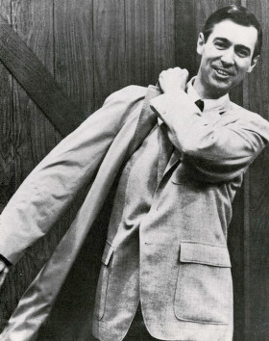
Share everything
Share
Notes:
Remember your favorite teacher
Quote
“A teacher affects eternity; he can never tell where his influence stops.” ― Henry Adams
Present to work peers what you learned here
Blog

Slide 40

Be The Master
Notes:
So. Maybe you're not going to be presenting a tech mentor but there is no reason that you can't go home.
0:19:43
And take some of the information that you've learned here this week and share that with your coworkers.
0:19:51
So here's a resource that I love for you all to check out the if you haven't it's the latest book by Don and it's called be the master.
0:19:59
And it's a wonderful read.
0:20:12
And really want to focus is on just going to break it down in a couple in about 30 seconds for you here is it focuses on this concept that.
0:20:14
We have things to share with people.
0:20:27
And. We should be the master.
0:20:30
Of our information and provide that down to other people.
0:20:36
That could be of use for that could use that information as well so it's based on the.
0:20:43
Model that we see often times in the trades where you have apprentices that apprentice to a master and then you have a journey man that often works with those
0:20:52
apprentice is it is working to be a master.
0:21:03
And. What we learn is that all of us have something to share so we should be going out that are in sharing those so things like you know your
0:21:06
work peers doing blogs video snippets text nips is a?
0:21:18
Company started by Adam bertrum who is a power shell MVP and a good friend of mine and they do a really good job of presenting material and giving people
in audience. To put and share their information.
And one of the ways you can be “The Master” for others is to blog…

Slide 41
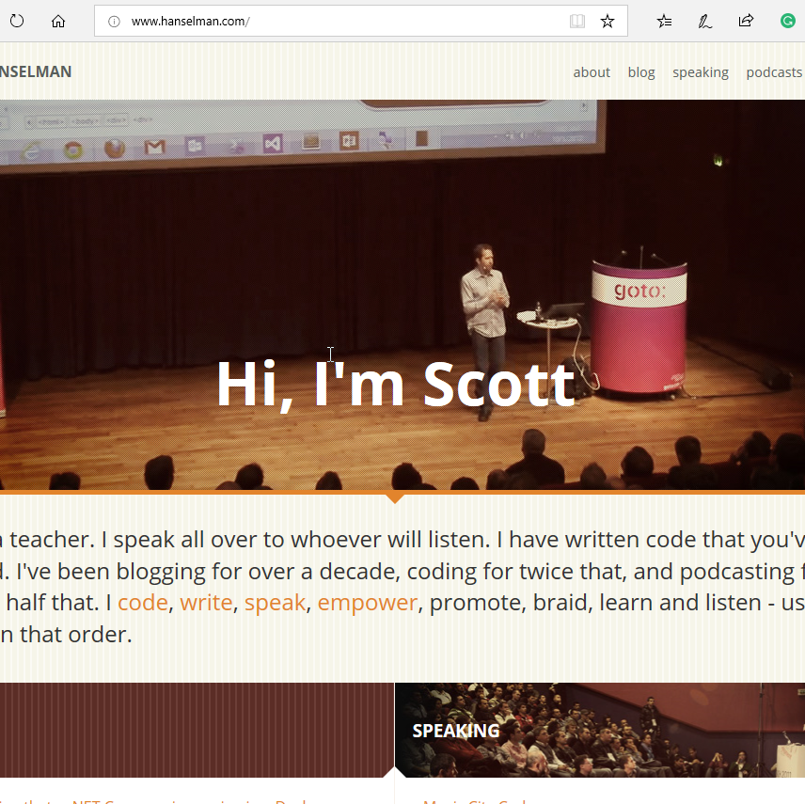
Blogging
Notes:
Better Story of Providing value from Blogging
DHCP Blog Post
Post Blog on Getting Started with Azure
Share what you know
Your documentation on the Internet
Why re-invent the wheel
Write what you want
So blogging is probably one of the easiest ways to go about the process for sharing what you know.
0:21:37
So as you can see here on this is Scott hanselman's web page hansman akamaihd been following stop for a long time even though I'm not a developer I do
0:21:47
code however. Ah he talks about many things that have.
0:21:59
While they deal with wrong code talks about things that makes sense to me in one of the biggest things that he said for a number of years is that.
0:22:04
You know. Why tweet something or white email something when you can write a blog post on it?
0:22:13
So let me give you a real world example here as a quad opps advocate one of my roles is to help it pros and people in operations.
0:22:20
How could they were pretty get to the cloud and part of that is helping them have a framework a learning path a way of finding the information they need
0:22:31
to get there so I get multiple messages?
0:22:41
Emails offered for pens about you know how do I learn azurin this is bad in the other thing.
0:22:44
Let's say I have 50 of those.
0:22:50
If I responded back to each one of those?
0:22:52
Chances are it's going to be the same information I might tweak it for that specific person but it's going to be a giant same general path of these are
0:22:57
the things that I swear I think you should start and that sort of thing so.
0:23:05
I chose to blog it I choose to block my ideas of here's how to get started with Azure.
0:23:11
So that's my documentation in the Internet it saves me from reinventing the wheel so I can tell that person I can reply to an email Hey Hey check out
0:23:17
my blog post here at really goes into depth here's how to get up to speed on Azure.
0:23:27
And based on some of the things you say here's some feedback that I have for you and feel free to email me back or comments on the blog about
0:23:32
questions that you have in those sorts of things and notice on throw out the commenting on the blog but.
0:23:40
That Ben gives gets them.
0:23:46
Publicly in the communication so that chances are the questions that they might have about my learning path is the same question that somebody else is reading that blog has
0:23:49
as well so I think blogging is a really great place to start for them.
0:24:00
It could be written you could also do a video blog as well.
0:24:05
The next thing is networking.(Trans)
Scot Hanselman ref
Use as your Internet Notebook & Way to Share
Why use email/Social to answer same question X times when you can write a blog post once
Simple
Cheap
Unlimited reach

Slide 42

Luck
Notes:
Were you in the right place at the right time
Or
Did you put yourself in a position to be in the right place?
Being in the right place at the right time is sometimes needed
I also believe you make your own luck by setting goals, building your knowledge, and building your brand.
Put yourself in a place where you can take advantage of that ‘lucky’ opportunity
Transition: So you might be saying ‘How do I start putting all this together’, well let’s look at a new career path.
Hard Work
Dedication
To be honest, luck plays a big part of all the pieces lining up in your career
Transition: Let’s take a look at each piece. First let’s talk about your vision.
And that brings us to the last place which is luck.
0:27:26
So when we talk about walk lots one of these hard things because there are people out there that believe that there is no lock that you create your own
0:27:30
luck that. What do you do?
0:27:42
Puts you where you should be in you get what you should should have gotten so it kind of comes down to where you in the right place at the
0:27:46
right time or did you put yourself in the position to be in the right place at the right time.
0:27:54
And I'm not really here to tell you.
0:28:01
Which of those is true?
0:28:06
I have some firm beliefs as far as.
0:28:08
What I've seen in my career?
0:28:12
That I know when I look at things you know hindsight is always 2020 as we know that if I look at things I can look at where I am
0:28:14
now with my career that.
0:28:25
There are certain things if certain things did not happen the next thing wouldn't happen and I wouldn't be here you know you see those movies and they talk about
the butterfly effect and. You know it's hard to determine OK what's locked and what part of the did I actually put my position to be in the right place.
0:28:37
So I think we're the answer really comes down to is that.
0:28:49
In all actuality. What does provide a part being?
0:28:53
In the right place at the right time.
0:28:59
But along with that. We need to make sure that we're putting ourselves into position to take advantage of those opportunities that when they come up so it's kind of
0:29:03
the word people say you make your own luck.
0:29:15
Well. In essence you do kind of make your own luck if you put yourself in a position for a dream opportunity to take advantage of that opportunity may be
0:29:18
lucky that it was available.
0:29:30
But you put yourself there so that you're able to take it to be honest luck plays a part in all of the pieces.
0:29:32
Lining up. So. So as you probably notice there all this.
Stephen King’s Book on Kennedy Assasination
Being in the right place at the right time is sometimes needed
I also believe you make your own luck by setting goals, building your knowledge, and building your brand.
Put yourself in a place where you can take advantage of that ‘lucky’ opportunity
Story about someone who appears lucky, yet really put themselves in a position to take advantage of opportunities.
Transition: So you might be saying ‘How do I start putting all this together’, well let’s look at a new career path.

Slide 43

5 hours a week
Notes:
5 hrs/week is lunch in a conference room vs lunch out with your team
It’s a commitment to yourself
YMMV
5hrs/wk > 20hrs/mo 240hrs/yr
or
Your lunch hour for the next year
P.S. Think of all the money you'll save. You've now paid for any books, online training, etc.
$10/day (3x week) = $30
48 weeks = $1440
Now's the time to talk about it So what is.
0:32:15
5 hours a week so if you think about it it's a lunch hour.
0:32:19
If you have an hour for lunch?
0:32:24
That's your 5 hours a week.
0:32:27
It's a commitment. To being better tomorrow than you were today.
0:32:29
And you'll see many people out there Bill Gates warm buffet a lot of different people you hear about all of these CEOs and everything how they do all these
0:32:36
readings and they they are committed to learning.
0:32:46
That 5 hours it's probably.
0:32:49
Minimum entry level if you're not spending 5 hours in some fashion.
0:32:54
To learn for yourself. You're probably doing yourself a disservice think about how much time your kids are spending learning everyday while they're in school.
0:33:00
So 5 hours a week comes out to be.
0:33:13
240 hours a year. So.
0:33:16
That's a lot of time So what does that breakdown into.
0:33:21
So what can we do in 240 hours a year.
Probably do. 45 X courses.
0:33:28
We have probably read 15 bucks.
0:33:34
We could probably do. 8 to 10 on line courses.
0:33:37
So if you think about that.
0:33:43
Depending on what you're learning looking to move towards.
0:33:46
You could probably learn and great set of skills.
0:33:51
240 hours a year. So.

Slide 44

240 hours a year

Slide 45

Making it Work
Notes:
How much should you commit?
0:34:01
That's an interesting question and it's all going to come down to each one of you.
0:34:04
Because we all have certain commitments to our families.
0:34:08
We all have time commitments we have work commitments we have a monetary commitment.
0:34:13
So how much time you are going to commit is something you have to look at it you have to think about it OK.
0:34:20
What am I willing to give up?
0:34:28
To make that balance. Because if you can't do a lunch hour you need to move that into some other time so is that going to take time away from
0:34:31
your family is it going to be times late at night is going to be able time on the weekend.
0:34:40
You need to really think about that and use that to determine how you're going to move forward so once you've determined that.

Slide 46
Career Path in Cloud Operations

Slide 47
Career Mission
‘Empower businesses to achieve their goals through effective use of cloud technologies’

Slide 48
Breakdown the Career
Be a Problem Solver
Coding (PowerShell)
Version Control (Git)
Pick a Cloud; Any Cloud
Choose your Cloud Arena
Understand how Business Works
Notes:
We can then talk about building a new career or moving towards a career so I thought it be easier idea to have a sample career for you to move
0:34:56
towards so. Cloud operations so in general what spot operations operations is.
0:35:08
Operating in a cloud infrastructure that could be hybrid meaning you have an on premise organization connected to the cloud it could be fully cloud which would be a public
0:35:17
cloud. And managing. How the infrastructure pieces of those works?
0:35:30
So. Let's break that down into some areas that I think are important if you're looking at cloud operations.
0:35:40
You need to have a background in the coding 'cause whether we like it or not.
0:35:48
Coding is an important part of what we do is specially in the windows world power shell is extremely important so if you're looking to build a cloud operations Korea
0:35:54
and. Looking at aszure even if you're looking today to be OS both platforms are manageable with power shell so I think power shell is a great place to start
0:36:05
learning especially since many of you are probably in the windows world so.
You should be using power shell anyway.
0:36:20
If you're coding which you are if you're building scriptswitch you may be doing you should be using some sort of the version control such as github or viesti?
0:36:23
Visual studio team services and things like that the reason is.
0:36:34
As companies are moving into cloud infrastructure and also using these things called that you probably heard of DevOps version control is a major part of how these things work.
0:36:40
And version control isn't just for software could be for configuration so if you're using power shell desired state configuration and your organization.
0:36:53
Version control an. Maintaining the configuration files in those sorts of things as important.
0:37:03
So you need to pick a cloud and any club I of course would prefer that you move up to Azure since I work for Microsoft but there is a
0:37:12
WS there is Google there's other clouds that are available.
0:37:22
The important thing is that you pick one and you start diving in and learning about it and here's where the kind of the rubber hits the road is that
0:37:26
for the most part the clouds all work the same.
0:37:35
At a higher level they all do the exact same things there's things that differentiate each cloud from each other.
0:37:39
But from a learning getting into the cloud standpoint if you learn how storageworks in a WS.
0:37:47
It works pretty much the same way in Azure.
0:37:54
Might be some different features how you implemented bahbah but for the most part all of the clouds have pretty much all of the same.
0:37:58
Different pieces. Then you want to pick a piece picking area to work in.
0:38:08
Since many of us are it operations folks.
0:38:15
Infrastructure in the service or iess is probably a great way to start looking at storage and networking and compute virtual machines.
0:38:18
Those are the things that we probably want to start all looking at because it allows us to take what we know being on premises and moved back into a
0:38:28
cloud infrastructure. Maybe we want to go into platform as a service and that's where we're not really looking at it as an operating system we're looking at it as
0:38:37
a platform to put our applications and things on.
0:38:47
Maybe your company is going to be moving in the cloud but you want to have a currency Office 365 which for another service environment Salesforce those sorts of things.
0:38:52
You have software as a service.
0:39:04
And one of the most important things that I find that people really need to have a good understanding on is understanding how business works.
0:39:07
So even when we move up to the cloud.
0:39:16
We need to understand how business works we need to understand how companies work because if you know how companies work and you know how the cloud works then when
things come up at your company that you're working for.
0:39:31
And they're trying to solve a problem you can take that technical cop technical knowledge you know from the cloud you can apply it to what you know about the
0:39:36
business and how it works.
0:39:47
And you can develop solutions.
0:39:50
To meet those needs. So those are the areas that I think would be important if you're moving towards cloud operations so once you breakdown kind of what you need
0:39:53
to learn. The next thing to do is to set some goals and pick your train

Slide 49

Build Career Path
Define your Mission
Set Goals
Pick Resources
Get to Work

Slide 50
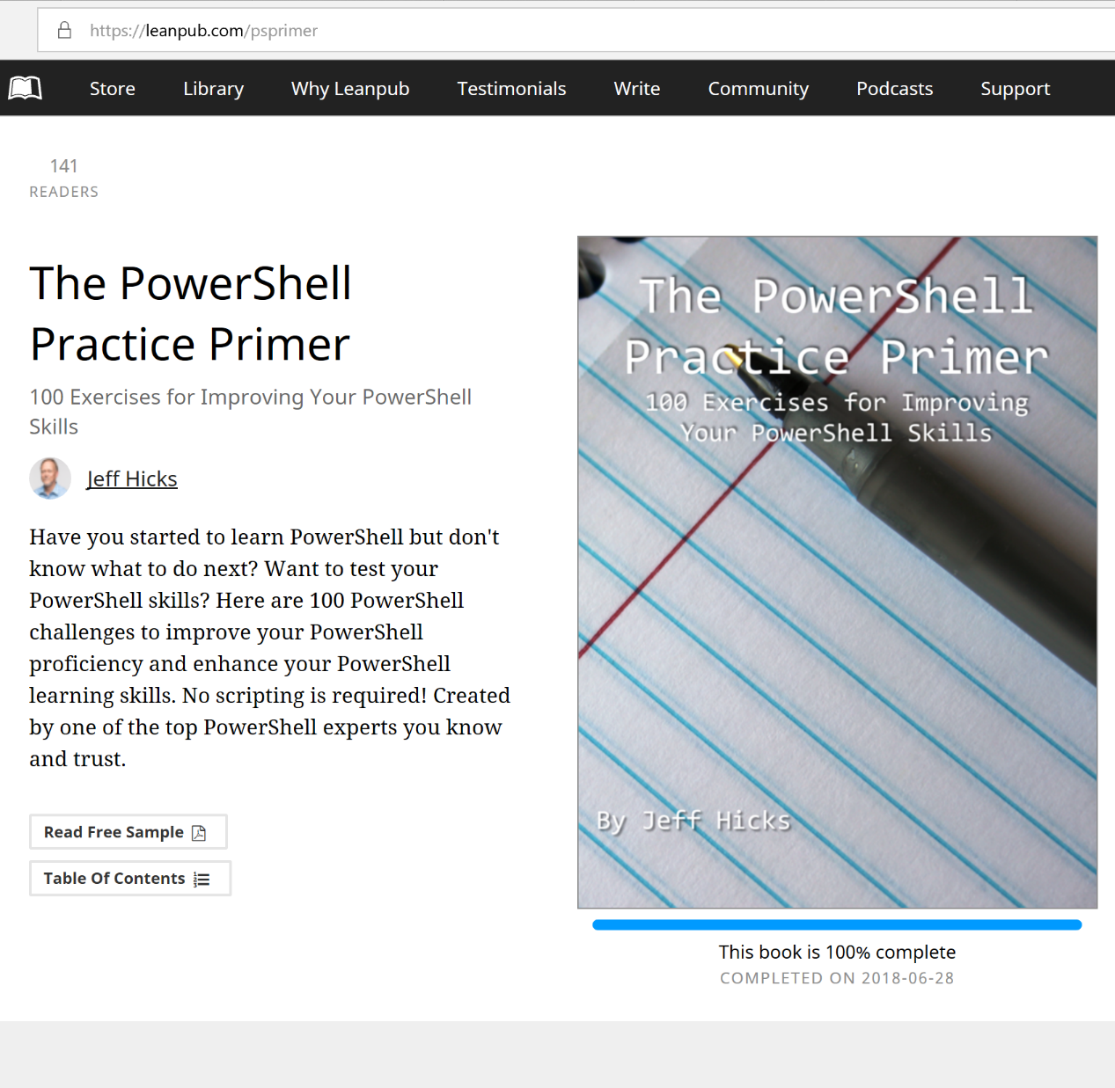
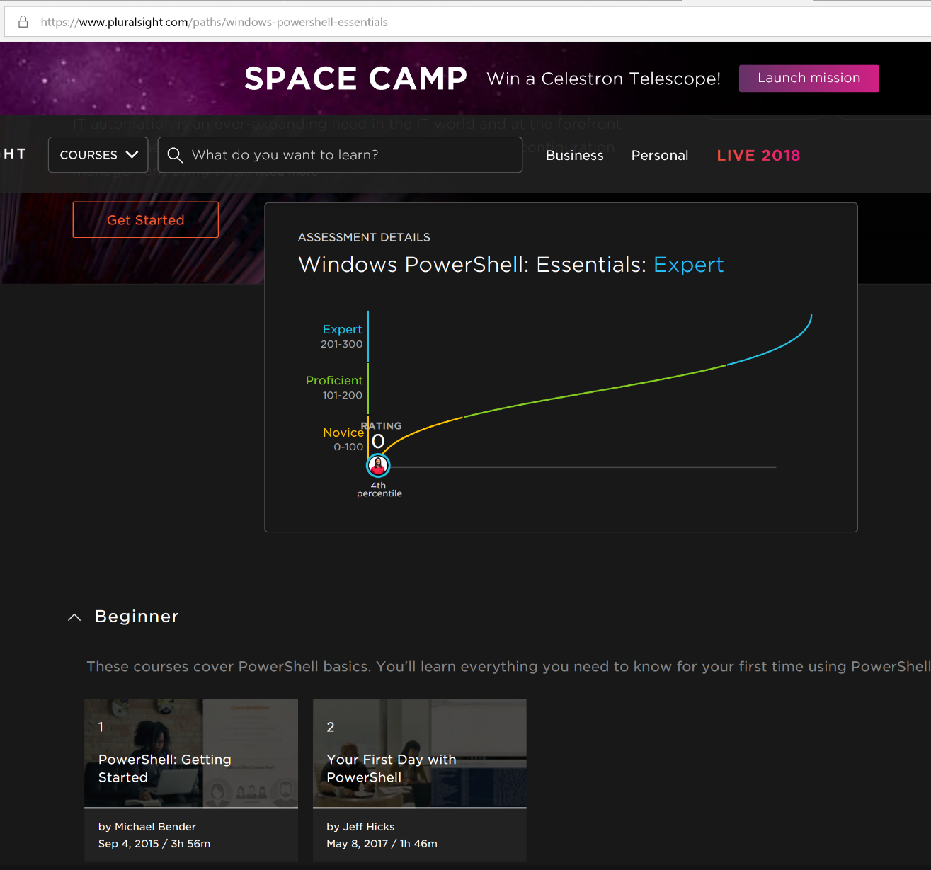

Learn to Script with PowerShell
Training Plan for PowerShell

Slide 51
Legacy
Notes:
Only You are 100% committed to your careerWhat you leave behind is just as important as what you do now
Just like your retirement, health, and family, you need to invest in your career.So share what you know
I can’t tell you what to spend; only you can

Slide 52

Were you here?
Remains
Notes:
Be the Master for someone
Be the teacher someone will remember & build their story based on

Slide 53
Call to Action
Review your Week
Pick Three
Plan for One
Share Everything
Define your Mission
Notes:
RevieSpend time on the way home reviewing your week
Write out your mission Statement
Decide what you want to do when you grow up
Pick 3 items you think would be good for you to learn more about (go deep)
Plan to spend 5 hrs/week on 1
Let me know on Twitter what you are working on
Tighten Up
So what I'd like to do is I'd like to leave you with a call to action.
0:47:21
So ask that you do some things.
0:47:26
When you leave here whether it's a plane ride hot some of you might be driving to your home so please those of you that are driving don't don't protect
0:47:31
him this but I think you can find time to do this?
0:47:39
What I'd like you to do is I'd like you to think about the week that you've had and think about 3 items?
0:47:43
That would be good for you to learn about and go deep on.
0:47:51
Maybe it's something with power shell maybe it's something in security maybe you learn some cool Office 365 stuff maybe it's an Azure a WS whatever that list take those
0:47:56
3 items that. You were interested about and you think you'd be passionate about.
0:48:08
Plan to spend. And create a plan to spend 2 to 5 weeks.
0:48:16
On one of those items.
0:48:23
So depending on what it is it might take a number of weeks or months to go through it.
0:48:27
But create that plan. Then what I'd like to do is reach out to me on Twitter.
0:48:32
Also have other contact information through my blog I'd love to hear what you're planning to learn.
0:48:39
So that I can see what you're learning and chances are.
0:48:45
Some of what you're sharing may be helpful to me coz remember what we said every interaction that we have with a person.
We always learn something from that person.
0:48:57
So with that. Here's the link to the resources page so you can go out to my blog it's all get to my.com so I have the URL here you
w

Slide 54
Take-Aways
Find your passion
Invest in YOU
Share Always
Embrace Change
Learn Every Day
Be better tomorrow
Notes:
So what we're really going to cover is 3 specific areas first one is akarere what makes up your karere so we'll talk about that won't break that down into
some areas that. May make sense to you may not make sense you but you'll take some stuff away from that we're going to take a look at resources to
learn so we're going to look at a number of different resources I'm going to provide you a number of resources.
That I think will be really helpful as you're going through and trying to learn something new and build out a career.
And then we'll talk about where do we go from here so as you're on the way home I'm going to provide you some things as far as how to
get moving forward tomorrow next week next month next year.

Slide 55
Thank you for sharing your time with me today!
Notes:
So with that I will give you some time back for the rest of your day.
0:50:11
I want to thank you for sharing your time with me today.
0:50:16
And I seriously mean that because you may be investment of coming into this room because I put together something about 5 months ago that.
0:50:20
Piqued your interest and I hope that I was able to the ride you with some information that you can take and be immediately effective.
0:50:32
Have a great day and thanks for coming up?
0:50:43

Slide 56
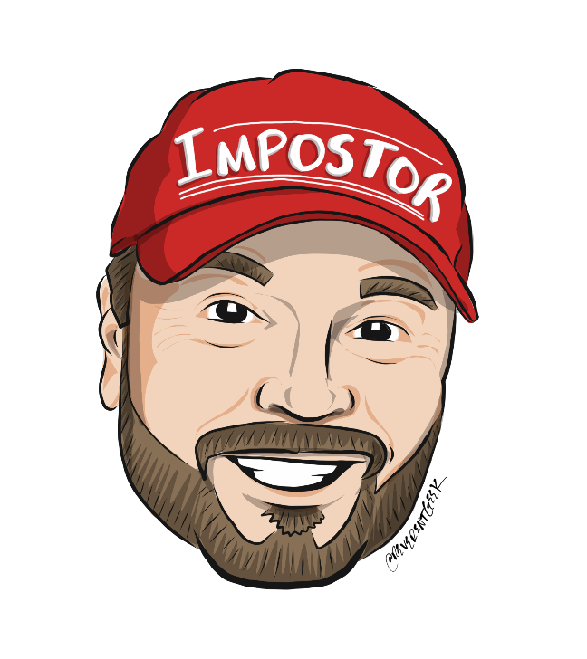
Resources & Contact Information
Twitter @Michaelbender
Michael.bender@Microsoft.com
Presentation Resources: https://aka.ms/mb_blog
Notes:
RevieSpend time on the way home reviewing your week
Write out your mission Statement
Decide what you want to do when you grow up
Pick 3 items you think would be good for you to learn more about (go deep)
Plan to spend 5 hrs/week on 1
Let me know on Twitter what you are working on
Tighten Up
So what I'd like to do is I'd like to leave you with a call to action.
0:47:21
So ask that you do some things.
0:47:26
When you leave here whether it's a plane ride hot some of you might be driving to your home so please those of you that are driving don't don't protect
0:47:31
him this but I think you can find time to do this?
0:47:39
What I'd like you to do is I'd like you to think about the week that you've had and think about 3 items?
0:47:43
That would be good for you to learn about and go deep on.
0:47:51
Maybe it's something with power shell maybe it's something in security maybe you learn some cool Office 365 stuff maybe it's an Azure a WS whatever that list take those
0:47:56
3 items that. You were interested about and you think you'd be passionate about.
0:48:08
Plan to spend. And create a plan to spend 2 to 5 weeks.
0:48:16
On one of those items.
0:48:23
So depending on what it is it might take a number of weeks or months to go through it.
0:48:27
But create that plan. Then what I'd like to do is reach out to me on Twitter.
0:48:32
Also have other contact information through my blog I'd love to hear what you're planning to learn.
0:48:39
So that I can see what you're learning and chances are.
0:48:45
Some of what you're sharing may be helpful to me coz remember what we said every interaction that we have with a person.
We always learn something from that person.
0:48:57
So with that. Here's the link to the resources page so you can go out to my blog it's all get to my.com so I have the URL here you
w

Slide 57
Rough Intro Take from Microsoft Speaker Training introducing talk
:
Building a New Career in 5 Hours a Week

Slide 58
Join Me for Building a New Career in 5 Hours a Week
TechMentor 20
August 9th, 2019
2:15 in Kodiak

